Slide 1
Clustering Victims of Domestic Violence to Tailor Outreach Strategies
India DHS Surveys 2015-2016
Mary Scott Sanders 10/2018
Notes:
Clustering is a type of ml typically used for marketing purposes that help marketers find the major groups within their customer base/audience so that they can tailor their strategies to each of those major groups accordingly. K Means clustering in particular allows you to specify a group of features that you would like to use to segment the audience and a number of groups you would like to end up with.

Slide 2
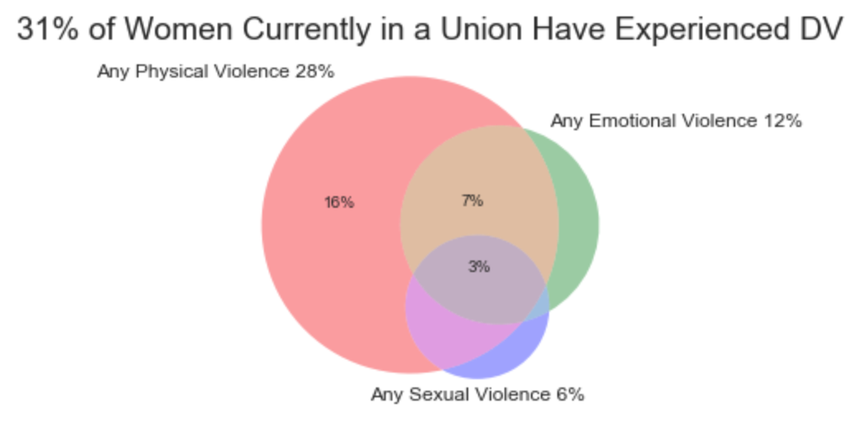
Domestic Violence is a Pervasive in India

Slide 3
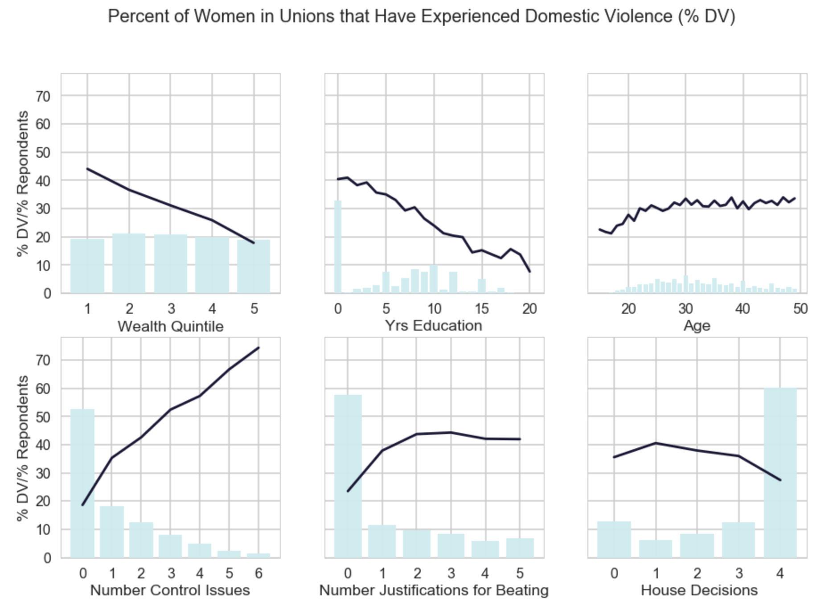
Domestic Violence is a Complex Problem

Slide 4
Domestic Violence Requires a Complex Set of Solutions
Proper Legislation
Police and Prosecutor Training
Medical Professional Training and Additional Crisis Centers
Social Campaigns portion this analysis aims to address

Slide 5
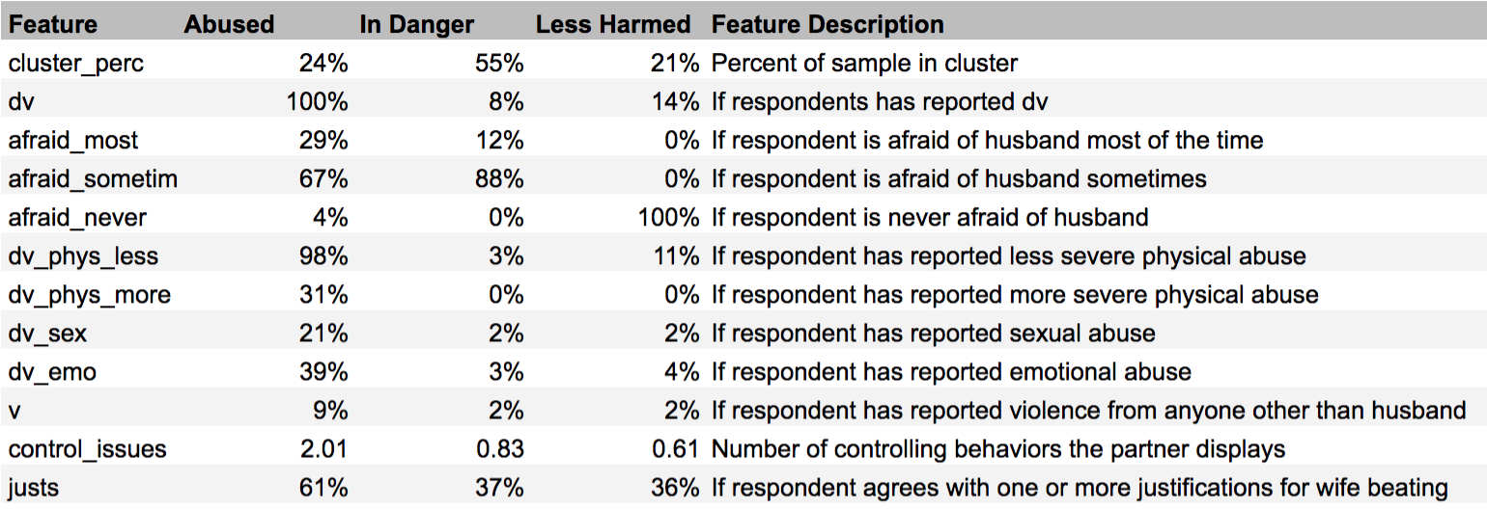
Results from Clustering by Experience with DVering by Experience with Domestic Violence
Abused: Experience many forms of dv, often afraid.
In Danger: Mostly do not report dv. However, partners display controlling behaviors, often afraid.
Less Harmed: Mostly do not report dv, not afraid of partners. Wealthier, better educated, more access to technology.

Slide 6
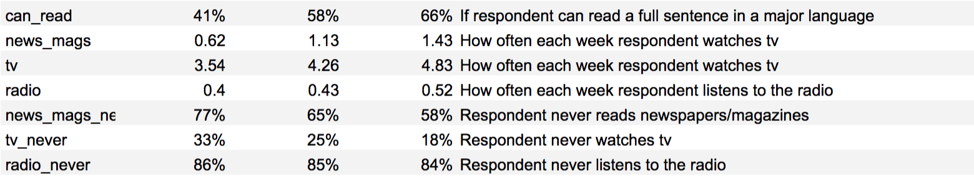
Results from Clustering by Experience with DVering by Experience with Domestic Violence

Slide 7
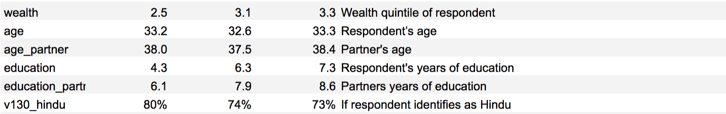
Results from Clustering by Experience with DVering by Experience with Domestic Violence

Slide 8
Recommendations
Mechanisms
“Abused” group hardest to reach, but may be most accessible via tv
Educational institutions should be leveraged, but need to start early, “Abused” group’s partners average 6 yrs education
Messages
Target less educated, lower income, more rural audiences
Convert 20% of partner’s from “not abusive or antagonistic” to “advocates.”
Convert 50% of partners from “antagonistic but not abusive” to “not antagonistic.”
Convert 30% of partners from “abusive” to “not abusive.”
Convert 42% women from agreeing with justifications for beating. Affirm worth.
Educate 20% of women who are abused but not reporting on how to access resources

